Slide 1
ITSC 203:
Offensive and Defensive Tool Construction
Module 4: CTYPES + Debuggers
Notes:
1

Slide 2
ctypes
The ctypes modules is an external python module. Python¹ refers to this module as a Foreign Function Library (FFL).
It is a built-in module available when you type the instruction:
import ctypes
It allows python code to implement datatypes and make function calls to native Dynamically Linked Libraries (Windows) or Shared Object Libraries (Linux). The native libraries are usually built using the C language, which means that their interface following a certain standard or convention. Using the module allows the developer to exploit that fact to access their functionality.
[1] ctypes — https://docs.python.org/3/library/ctypes.html

Slide 3
Rationale for ctypes
There are times when developers must make a choice to build their own code from scratch or borrow and implement pre-made tools to accomplish the task. In the case of native DLLs and Shared Object files, some the decisions include the following:
Revise already built modules that can access low level features of the operating system.
Try to enhance code that has been tested and proven by generations of engineers.
The choice can be difficult especially when you consider that Python is constantly being developed. This means that what was once not possible is now implemented within python natively. Albeit, there may be some performance hit for large dataset.

Slide 4
When not to use python
If it is already built, don’t rebuilt it.
Other than the above reason, the other choice is if you want to hide the implementation of some proprietary code. If that is the case, implementing it as a compiled C/C++ module is the obvious choice. The Python equivalent although very portable means you automatically lose control over who can see the “magic behind the curtain”.
There are times when Virtual Machine (VM) gets in the way. Although there are multiple implementations of the VM, (Cython, IPython, etc), running the byte code there are still some penalties in performance to pay.

Slide 5
The basic
Linux implementation
from ctypes import * # import all of the ctypes namespace
libc = CDLL('libc.so.6’) # Create the object libc by opening the library libc.so.6
libc2 = cdll.Loadlibrary('libc.so.6')
libc.printf(b"Hello World") # Call the printf function inside the libc.so.6 binary
libc2.printf(b"Hello World")
Windows implementation
from ctypes import * # import all of the ctypes namespace
# Create the object msvcrt by opening the library msvcrt.dll
msvcrt = WinDLL('msvcrt.dll’)
msvcrt2 = windll.LoadLibrary('msvcrt’) # No extension required
msvcrt.printf(b'Hello World\n’) # print Hello World
msvcrt2.printf(b'Hello World\n’) # print Hello World

Slide 6
Calling Convention
There are some interesting things happening that we should dig into slightly.
When we make a call to a function, using ctypes, we are following a convention. We should be aware of what they are and not ignore them. Ctypes loads these libraries and exports the functions in them according to a few well know conventions.
CDECL is the standard for Linux system and has the following characteristics:
Arguments are passed to the function from right to left
int fun1(lft, more_lft, less_lft, less_rgt, more_rgt, rgt);
EAX register stores the return value
The calling (caller) function removes the arguments from the stack.
Arguments are placed on the stack

Slide 7
Calling Convention
STDCALL³ is the standard for 32bit Windows systems and has the following characteristics:
Arguments are passed to the function from right to left
int fun1(lft, more_lft, less_lft, less_rgt, more_rgt, rgt);
EAX register stores the return value
The called (callee) function removes the arguments from the stack.
Arguments are placed on the stack
Windows has an alternate standard called oledll, that follows the same convention as the stdcall with some additional features. For this course focus on understanding the stdcall calling convention.
[3] https://en.wikipedia.org/wiki/X86_calling_conventions#Microsoft_x64_calling_convention

Slide 8
Calling Convention
System V AMD 64 ABI⁴ is the standard for 64bit Linux systems and has the following characteristics:
The first 6 arguments are passed in registers RDI, RSI, RDX, RCX, R8 and R9
If more arguments are required they are placed on the stack from right to left.
RAX register stores the return value
The calling function (caller) removes the arguments from the stack.
The use of registers enhances the performance of the function call.
[4] https://en.wikipedia.org/wiki/X86_calling_conventions#System_V_AMD64_ABI

Slide 9
Calling Convention
Microsoft X64 is the standard for 64bit Windows systems and has the following characteristics:
The first 4 arguments are passed in registers RCX, RDX, R8 and R9
If more arguments are required they are placed on the stack from right to left.
RAX register stores the return value
The called function (callee) removes the arguments from the stack.
The use of registers enhances the performance of the function call.

Slide 10
Why calling convention
Understanding how the functions expect data ensure that the values are placed in the right order to make the function calls.
The ensures that you understand then when building your own modules to be used by python you have to maintain this standard to ensure interoperability.

Slide 11
Creating our own library
You can think of a library as a binary file that contains only functions that will be performing a task. To this point we have abstracted the idea of a library as simply a Blackbox which we don’t consider. We simply make a request to use printf and the compiler resolves that request.
Let’s open that Blackbox and try to understand what is happening.
The following is one possible sequence to use the printf function in a program.
Create myfile.h – contains other header files, constants and prototypes
Create myfile.c – makes reference to myfile.h and contains printf statements
Compile the file and execute the program

Slide 12
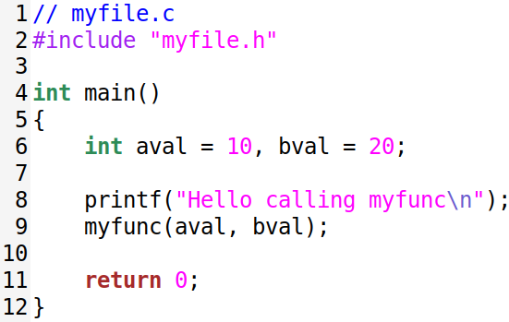
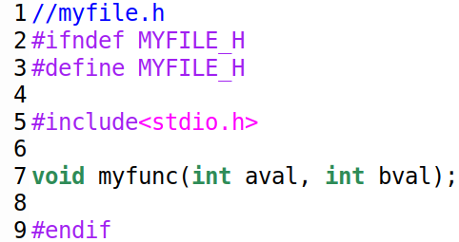

Steps 1 and 2
Left top: C code making a call to printf and myfunc
Right top: Header file with prototypes and preprocessor call for stdio.h
Bottom: Commands used to build library and execute myfile
executable and final output of the program.

Slide 13
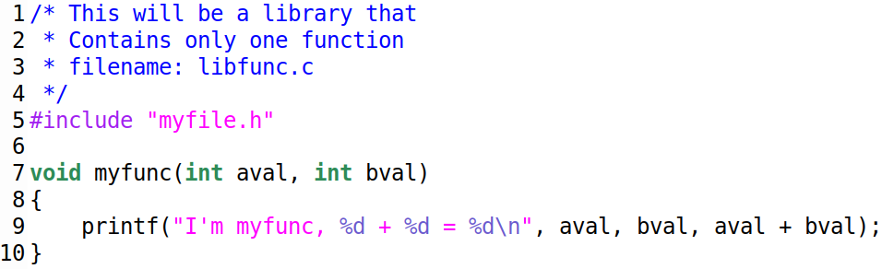
Step 3
Now the final C file to create the library.
Notice the code below does not have:
Prototype
Main
You can put more functions to make this more interesting and capable
You create the final library file with the following commands:
gcc -Wall -shared -fPIC libfunc.c -o libfunc.so

Slide 14
Challenge
Create a new c file that contains 2 functions:
void divide(int aval, int bval);
the function prints the result of aval / bval
void multiply(int aval, int bval, int cval);
The function multiples 3 values and prints the results to the screen
Use the filename mymath.c, and compile the files into 1 library called libfunc.so

Slide 15

ctypes … again?!!!
We have created our library but now what. How can we make use of that newly created library?
See the image showing the steps we can take to use this.
How can we find out what functions this new API provides to us?
nm -D <name of the library>
nm -D /usr/lib/x86_64-linux-gnu/libc-2.31.so
What other library can this be applied to?

Slide 16
ctypes … datatypes
The ctypes modules presents every possible datatype available in C to the developer a full can be found at the following link:
https://docs.python.org/3/library/ctypes.html#fundamental-data-types
A few of the common one we will use include:
c_int, c_char, c_char_p, c_short
In order to pass information to functions it is encourage that you use the argstype method. Its intended purpose is to ensure that when you send data from python that the types match the required entries on the other end. The intended purpose is to avoid catastrophe; as there is no means of type checking or exception handling within those modules, this means that you could crash your program or worse blue screen your VM.
printf.argparse = [c_char_p, c_int, c_char, c_char_p]

Slide 17
ctypes … creating types
The table below shows the creation of ctype object in python and the associated C declaration that goes along with it.
Python ctype declaration | ctype methods | C Declaration
astr = create_string_buffer("hello World!!!\n") | astr.raw, astr.value | char astr[ ] = "Hello World!!!\n";
astr = create_string_buffer("hello World!!!\n", 30) | astr.raw, astr.value | char astr[30] = "Hello World!!!\n";
astr1 = (c_char*30)() | astr.raw, astr.value | char astr1[30];
astr1.value = b'Below' | astr.raw, astr.value | strcpy(astr, 'Below')
astr1 = (c_char*30)(*(b'Welcome')) | astr.raw, astr.value | char astr[30] = "Welcome";
astr1 = ((c_char*30)*10)() | astr.raw, astr.value | char astr1[10][30];
intval = (c_int)(102) | intval.value | int intval = 102;
intval = (c_int*30)(102) |  | int intval[30] = {102};
intval[0]
intval = ((c_int*30)*10)() |  | int intval[10][30] = {0};
intval[0][9]

Slide 18
The Debugger
What is a debugger?
A debugger is a program that can allow the user to control the flow of execution of a program:
Executing one instruction at a time
Jumping over sections of code
Setting breakpoints
Analyzing the internal workings of a program to the most minute details
But to what end? Why go through the pain of analyzing what you or another person created?

Slide 19
Purpose - Debugger
As we all things in life the use of the debugger can be nefarious in nature but there can be also good intentions.
The bad:
Break the encryption algorithm, to allow eavesdropping or deeper analysis
Circumvent the developers restrictions, to reverse engineer and make a similar product
Access or learn of hidden features to provide more capabilities than the developer intended.
The good:
Break the encryption algorithm, to allow eavesdropping or deeper analysis
Circumvent the developers restrictions, to reverse engineer and make better defense
Access or learn of hidden features to build a deeper understanding and potentially provide attribution.

Slide 20
Debugger - Types
There are basically 2 types of debuggers:
Kernel mode
Requires special setup
Secondary computer as the current debugged computer cannot be accessed
User mode
Easier setup and fairly straightforward once the basic commands are understood.

Slide 21
Examples of Debuggers
The is a long list of debuggers currently available. The fall with the categories of Freeware, Shareware and Commercial. Below is a list of the few well known ones:
Immunity
OllyDBG
x64dbg
WinDBG
GDB
Radare r2
IDA Pro (primarily used as a decompiler)
Evans Debugger (edbg)
This is not an exhaustive list but givea perspective of what’s available.

Slide 22
Features of the Debugger
In order to be effective Debuggers need to have at least these features:
Set/Clear Breakpoints
Hardware
Software
Memory
Examine a range of memory
Current stack
Heap
Any section of memory available to the process.
Display current state of the process
Register status
Address of instruction to be executed
Decompile the entire text segment of memory

Slide 23
Features of the Debugger
Breakpoints
Hardware
Uses the DR registers in the CPU (Chap 2 – pg21-22)
Good for situations where process can detect debugging
Bad when you need more than 4 breakpoints
Software
Uses a lookup table and modifies 1st byte of the instruction, replacing it with 0xCC
Good if you need to monitor a lot of locations in the process
Bad if you don’t’ want the process to be aware of the debugger.
Memory
Uses permission on a page to determine if a process is writing, reading, accessing that page and that triggers a fault
Good for situations where code can detect debugger connected
Bad when you need to watch multiple pages at a time.

Slide 24
Python Debugger
The python debugger that will be analyzed in this course will require your use of python.
We will take a simplistic approach to this debugger as all the code required is provided to us by the author of the book: Gray Hat Python.
We will evaluate the code as well get a basic understanding of how debuggers work in general. Some features that we will understand:
What it means to attach to an process that is currently running
What it means to launch a process and break into to it.
We will also understand the difference in the two approaches and the impact that may have on our ability to debug.

Slide 25
Python within the Debugger
Python can also be used within the debugger to help speed up analysis. Or more importantly perform tasks that would otherwise be repetitive and tedious in nature.
Python has been employed in many debuggers including:
Ghidra
IDA Pro
Immunity
The use case of the language in these debugger range from simplistic to quite complex. One of the most popular python codes available for free is mona.py⁵. There is a repository of github for this project as well you should visit the site of the creator: https://www.corelan.be/index.php/2011/07/14/mona-py-the-manual
[5] https://github.com/corelan/mona

Slide 26
Questions
Have you heard of any interesting use cases of the Debugger?
Is a debugger a Black, Gray, White Hat Tool?
Is it reasonable to build an entire debugger using python?
How could you use components of the python debugger versus building the entire debugger.
Can all code (malicious and non-malicious) be debugged?
https://en.wikipedia.org/wiki/Debugger#List_of_debuggers

Slide 27
Book Resources
You will need to download the code from the book instead of trying to type it all manually.
Book website: https://nostarch.com/ghpython.htm
Code Download: https://nostarch.com/download/ghpython_src.zip
A few contributors have also gone through the effort of creating github repositories based on questions, requests and their own curiosity. You can also look there if you are lost and not sure of how to resolve an issue.
https://github.com/CoiroTomas/GrayHatPython3-x64/tree/master/src/chapter3/3.4
https://github.com/volf52/gray-hat-python

Slide 28
References
API
https://en.wikipedia.org/wiki/API
Calling Convention
https://en.wikipedia.org/wiki/X86_calling_conventions
https://en.wikipedia.org/wiki/X86_calling_conventions#List_of_x86_calling_conventions

